Slide 1
Lecture 5
Notes:
Copyright 1999, University of California

Slide 2



Client
host
Client
host
Server
host

Slide 3
Part of the rationale
Specialization:
  Clients specialize in user interface
  Servers specialize in managing data and application logic
Sharing:
  Many clients can be supported by few servers
  Often data and logic are shared among applications and users

Slide 4
“I want to
collaborate
with my
colleague”
“I want to access
some information”
Client
Server
Peer-to-peer
Client/server
Notes:
Copyright 1999, University of California

Slide 5
Distinctions
Client-server
  Asymmetric relationship
  Client predominately makes requests, server makes replies
Peer-to-peer
  Symmetric relationship

Slide 6
Email application
Server
Client
Client
Email client sends message to server
Later, recipient’s email client retrieves message from server
Message is stored on POP server

Slide 7
Chat application
Server
Client
Client
Chat server aggregates typing from all users and sends to all clients
Other user’s clients display aggregated typing from chat server
Chat clients send user’s typing to server

Slide 8
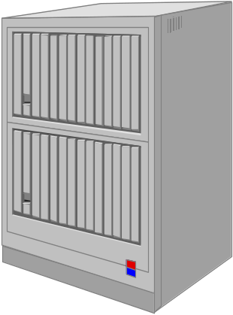
Three-tier client/server
Local-area network
Application
logic
Presentation
Note: many clients per
application server, several
application servers per data server
Shared
data
Notes:
Copyright 1999, University of California

Slide 9
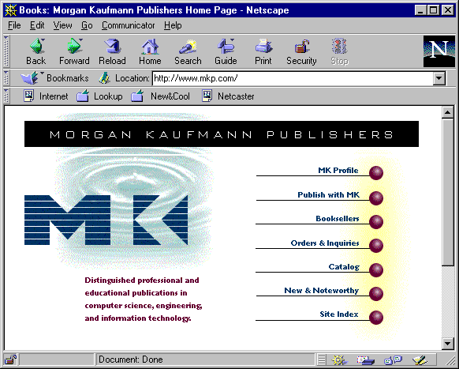

Client
Host architecture
Web
browser
Web
server
Common
gateway
interchange
Application logic
Databases and DBMS
Application partition

Slide 10
Practice in defining tiers
Online bookseller (e.g. amazon.com)
Stock trading system (e.g. Schwab or E-trade)
Notes:
Copyright 1999, University of California

Slide 11
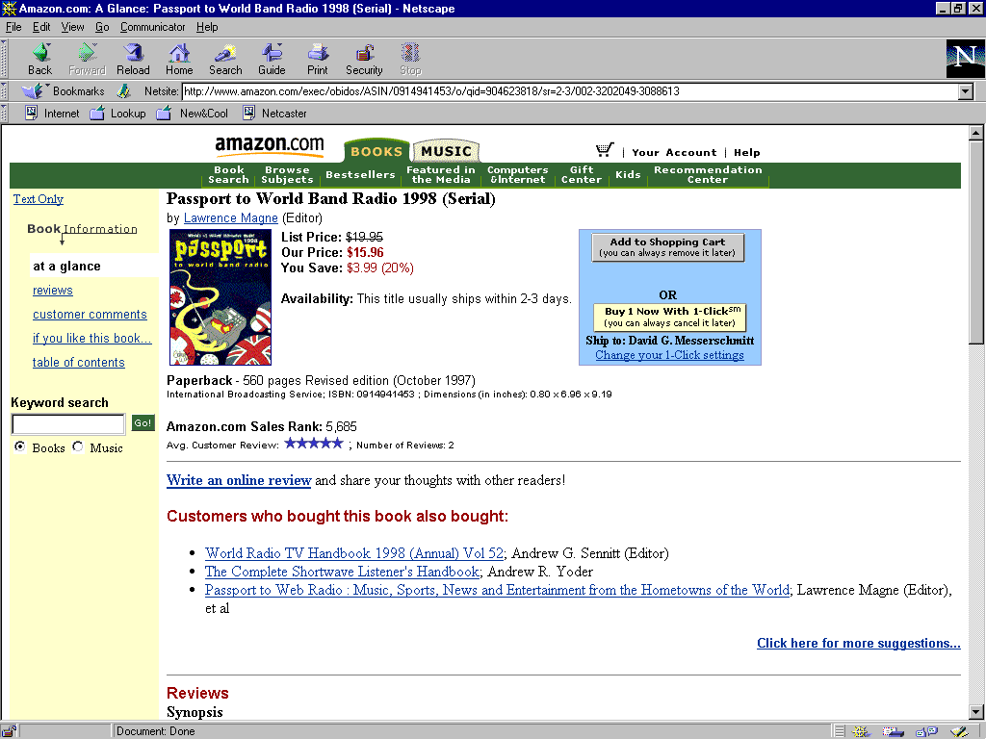
amazon.com
Notes:
Copyright 1999, University of California
What is presentation, application logic, shared data?
Presentation: Web browser
Application logic
Shared data

Slide 12
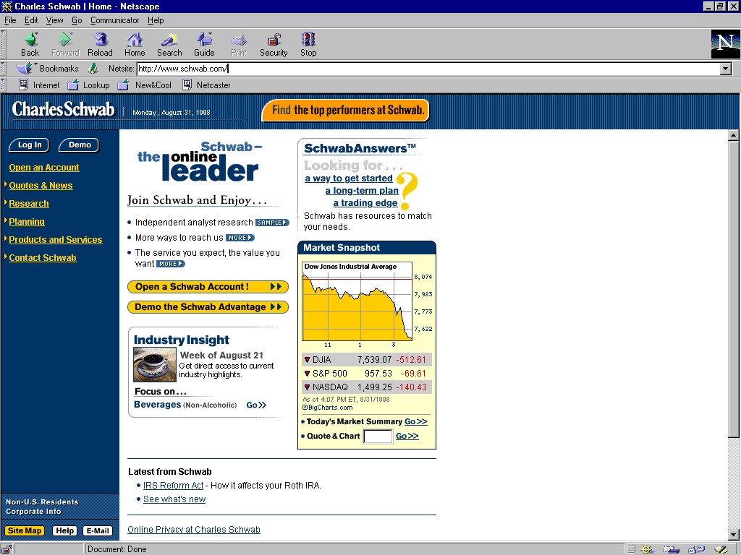
Schwab
Notes:
Copyright 1999, University of California
What is presentation, application logic, shared data?

Slide 13
Question
What types of social applications would be appropriate for a client/server architecture?
Notes:
Copyright 1999, University of California
Deferred applications need a server -- you wouldn’t want communication to fail because a client was turned off, and there is often a “consolidation” function (example chatroom)
Immediate applications can be done peer-to-peer -- if a client is turned off, no point to the application anyway. Also avoids server bottlenecks. Server may still have a role is filtering or consolidation.

Slide 14
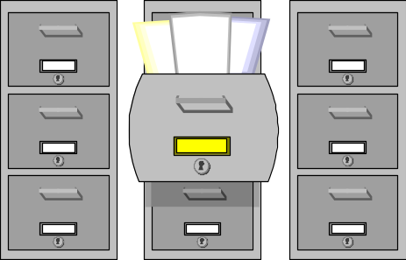

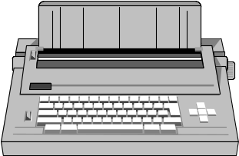
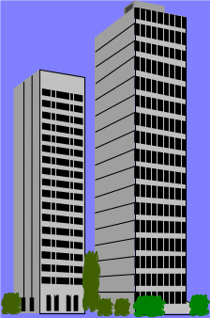
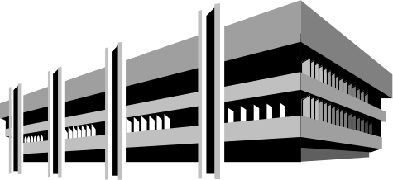

Departments
Enterprise-to-enterprise
Commerce
Consumer
Enterprise

Slide 15


software4u.com
Customers
Customer-service
department
Technical-support
department
Consumer
Enterprise

Slide 16
Consumer
application
Enterprise
application
Web
browser
Web
browser
Web
browser
Web server
Web server
Web server
Customer care
Customer logic
Agent logic
Technician logic
Databases
Customer
audit
Software
documentation
Problem
knowledge
base

Slide 17
Customers
Agents
Technicians
Customer logic
Agent logic
Technician logic
Databases
Accounts
Products
Orders

Slide 18

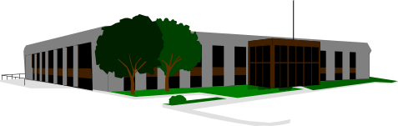
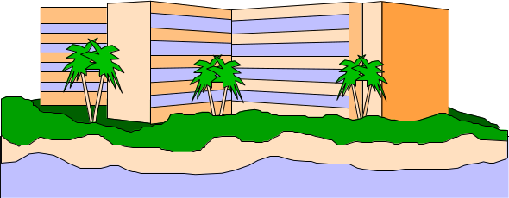
Financial institution
Book distribution
centers
Customers
books4u.com
Consumer
Enterprise
Inter-enterprise

Slide 19
Consumer
e-commerce
Inter-enterprise
e-commerce
Web
browser
Web server
Book merchant
Customer logic
Fullfillment logic
Outside links
Databases
Acquirer
bank
Book
distributors
Customers
Merchandise
Orders

Slide 20
Clients
Acquirer
bank
Customer logic
Fullfillment logic
Databases
Book
distributors
Customers
Merchandise
Orders

Slide 21
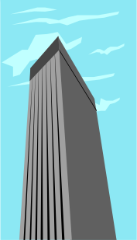


Information providers
Customers
Stock market
stocks4u.com
Consumer
Enterprise
Inter-enterprise

Slide 22
Consumer
e-commerce
Inter-enterprise
e-commerce
Web
browser
Web server
Stock trader
Customer logic
Trading logic
Outside links
Databases
Information
providers
Financial
markets
Accounts
Products
Orders

Slide 23
Clients
Information
providers
Customer logic
Trading logic
Databases
Financial
markets
Accounts
Products
Orders

Slide 24

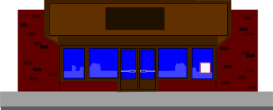
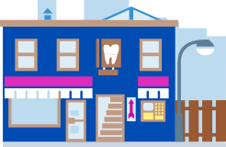
Financial institution
Customers
flowers4u.com
Local florists
Consumer
Enterprise
Inter-enterprise

Slide 25
Consumer
e-commerce
Inter-enterprise
e-commerce
Web
browser
Push server
Florist delivery
Web server
Push client
Customer logic
Fullfillment logic
Outside link
Databases
Acquirer
bank
Accounts
Products
Orders

Slide 26
Customers
Florists
Customer logic
Fullfillment logic
Acquirer
bank
Databases
Accounts
Products
Orders

Slide 27
Shortcomings of client/server
Departmental solution
Proliferates non-interoperable technologies and applications
Hardwired applications lose flexibility
What are some goals and likely characteristics of future enterprise architectures?
Notes:
Copyright 1999, University of California
Major goal: flexibility to meet new business opportunities and new organizational structures
More tiers to logically decouple roles
Away from stovepipe: horizontal as well as vertical structure

